Slide 1


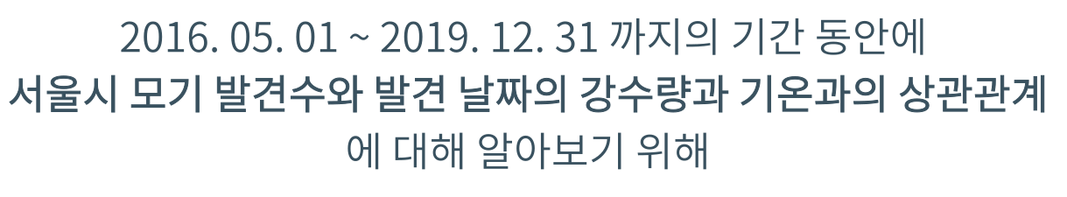



https://www.kaggle.com/kukuroo3/mosquito-indicator-in-seoul-korea

Slide 2
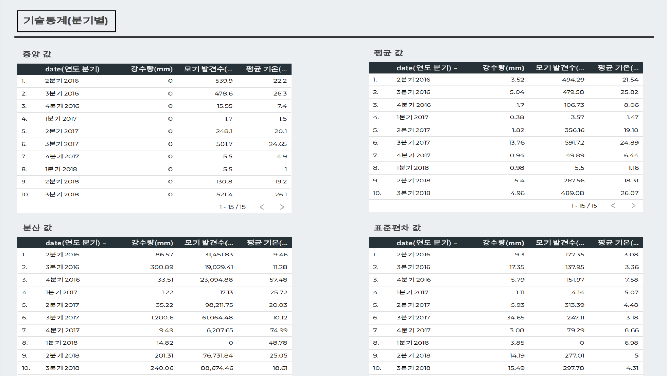
구글 데이터 스튜디오 주소 : https://datastudio.google.com/reporting/710b599a-26a1-40c2-919d-20957a477a87

Slide 3
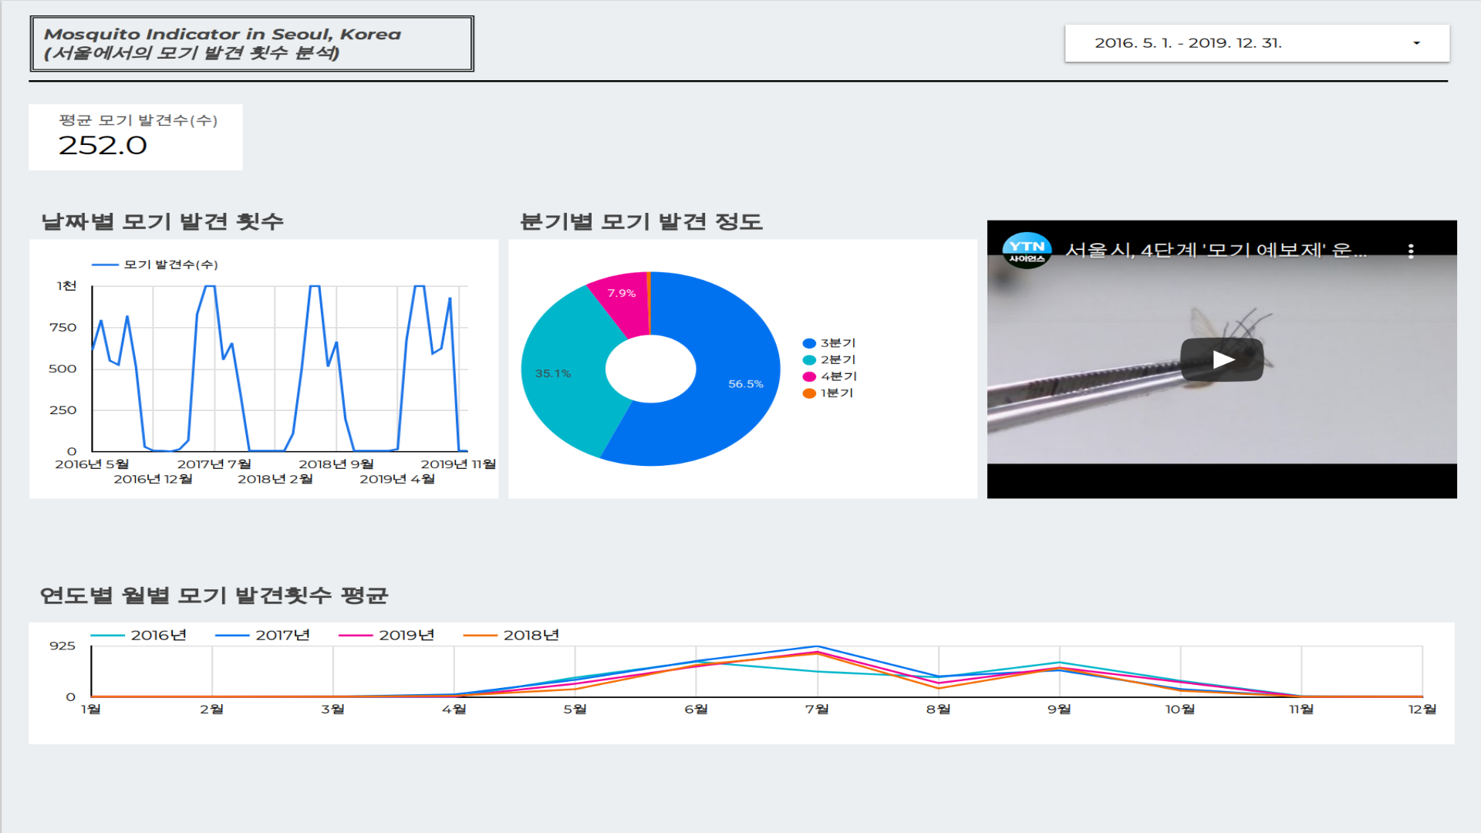

Slide 4
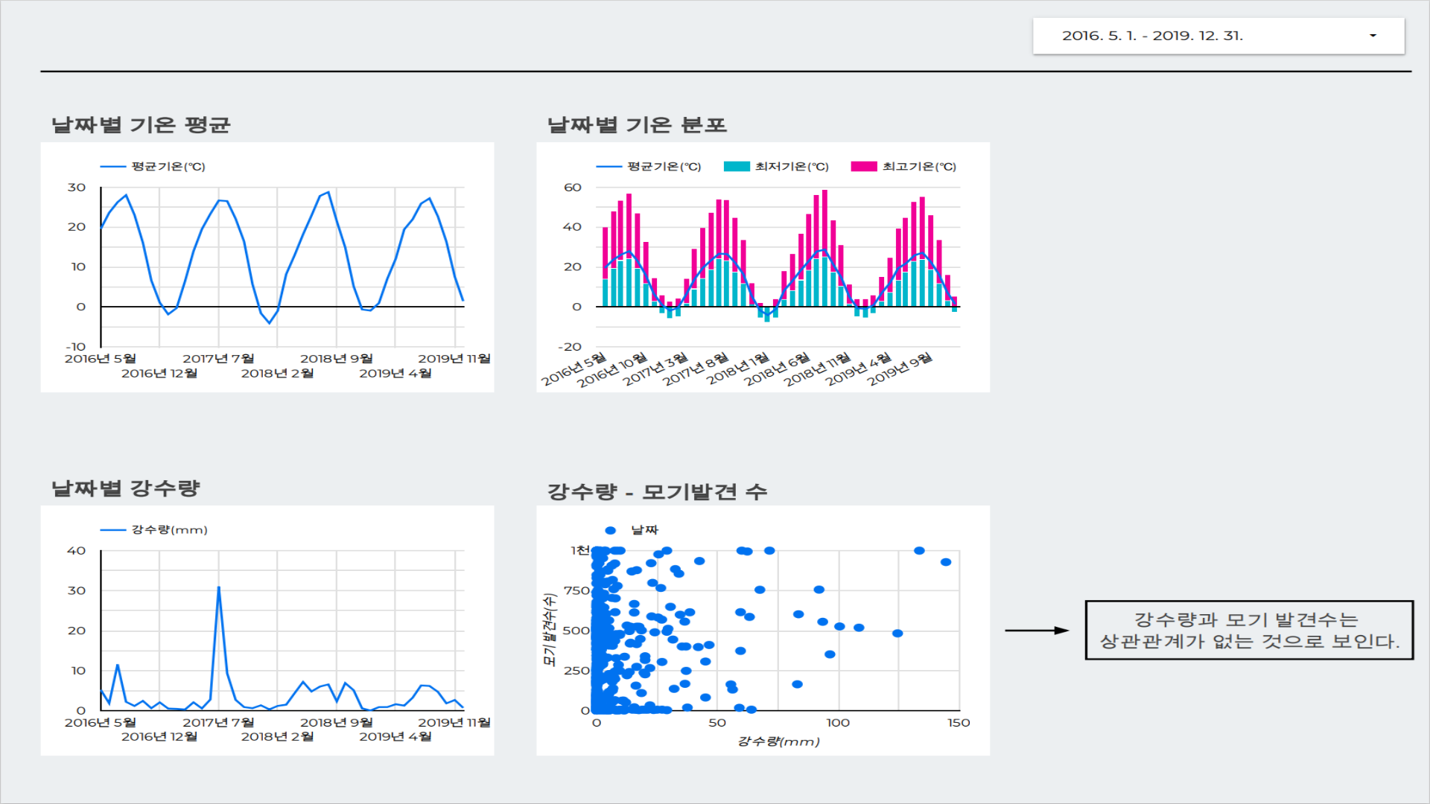


Slide 5
